Slide 1
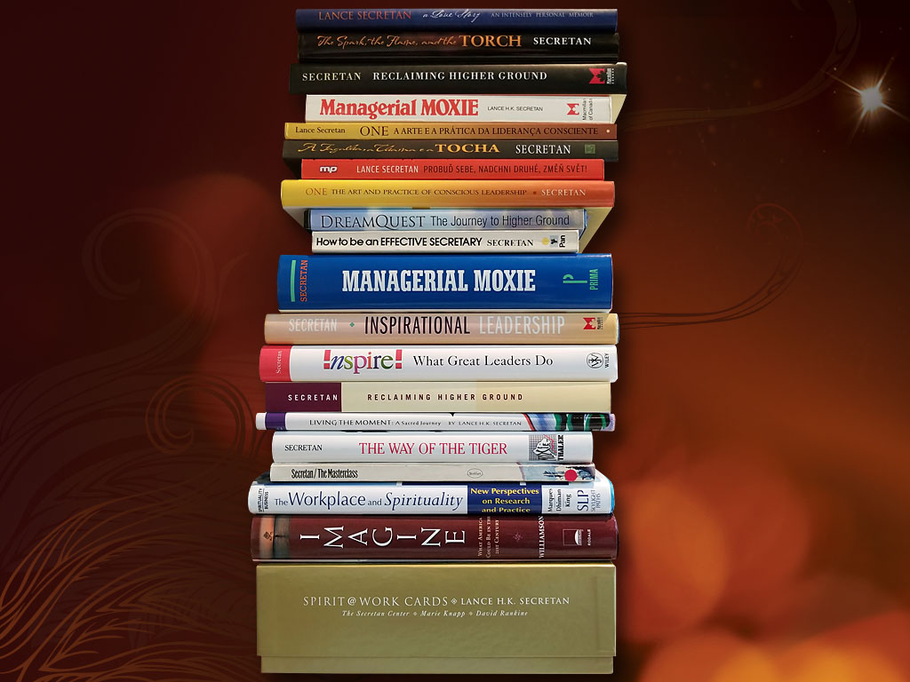

Lances_Books
The Secretan Center Inc.
An Overview
©The Secretan Center Inc. 2021
Notes:
Cool logo page here http://www.bing.com/images/search?q=univeristy+logos&FORM=HDRSC2#a

Slide 2

This short PowerPoint presentation is arranged so that you can easily skim across the offerings of The Secretan Center Inc. If you would like to expand on any of the frames, just click the “notes” view for additional information
Note to the Reader
©The Secretan Center Inc. 2021
Notes:
The Secretan Center Inc. is an advisory firm specializing in corporate and personal transformation, working with leaders, inspiring them and their teams to create inspiring organizations that change the world. The firm has helped 6 companies to be named to Fortune’s Best Companies to Work For in America list, 8 others are also clients, and 30 Secretan Center clients are on Fortune’s Most Admired Companies list. Dr. Lance Secretan is ranked 17th in the world by Leadership Gurus, and Speakers in America ranks him among the Top Five Leadership speakers. His firm, The Secretan Center, Inc., is ranked #1 in the world as an international Leadership Consulting firm by Leadership Excellence. The DreamQuest® is ranked the #2 best Train-the-Trainer program in the world. The name for this transformational work is Higher Ground Leadership® and it is described more fully in, The Spark, the Flame, and the Torch, one of the most recent of Lance Secretan’s 16 books.

Slide 3
Founded in 1972 as an Advisory firm dedicated to helping leaders create inspiring cultures. We call our work, “Higher Ground Leadership®”
The Sun
The Higher Ground
The Red Road of Life
©The Secretan Center Inc. 2021
Notes:
The Secretan Center Inc. is an advisory firm specializing in corporate and personal transformation, working with leaders, inspiring them and their teams to create inspiring organizations that change the world. The firm has helped 6 companies to be named to Fortune’s Best Companies to Work For in America list, 8 others are also clients, and 30 Secretan Center clients are on Fortune’s Most Admired Companies list. Dr. Lance Secretan is ranked 17th in the world by Leadership Gurus, and Speakers in America ranks him among the Top Five Leadership speakers. His firm, The Secretan Center, Inc., is ranked #1 in the world as an international Leadership Consulting firm by Leadership Excellence. The DreamQuest® is ranked the #2 best Train-the-Trainer program in the world. The name for this transformational work is Higher Ground Leadership® and it is described more fully in, The Spark, the Flame, and the Torch, one of the most recent of Lance Secretan’s 16 books.

Slide 4
Three Fundamentals
Our Philosophy
Focusing on People and their Passion, Meaning and Fulfilment first – and THEN the Metrics
The real need for most people is to have their sense of hope restored, their passion and inspiration reignited, and to believe that their leaders can be trusted and relied upon to guide them to a more inspiring world. Achieving this leads to dramatic changes in performance, engagement and success.
©The Secretan Center Inc. 2021
Notes:
For many years, corporate transformation, organizational development and leadership development has focused exclusively on the metrics and processes of high-performance. Traditionally, this has included numerous methodologies designed to enhance the metrics by which organizations measure performance. Leadership theories and task-orientated learning designed to achieve the maximum effect, for the lowest cost, in the shortest time, has been the priority of leaders. However, research shows that these are not the only priorities for most people and neither are they effective—in a multiyear research effort into more than 200 well-established management practices that were deployed over a ten-year period by 160 companies, researchers found that “most of the management tools and techniques we studied had no direct causal relationship to superior business performance”. This is because corporate transformation, leadership development and performance improvement “programs” are seldom successful on their own. A more effective approach requires radical and inspiring changes in leadership approach and employee spirit, accompanied by state-of-the-art processes. Intensifying our focus on the processes and technologies of high-performance—in other words, doing more of the same, with more intensity—will not bring about the improvements in performance we are all seeking. The real need for most people is to have their sense of hope restored, their passion and inspiration reignited, and to believe that their leaders can be trusted and relied upon to guide them to a more inspiring world. Achieving this leads to dramatic changes in performance, engagement and success. As we frequently tell clients, “The mind will only do what the heart tells it to.”
http://hbswk.hbs.edu/it is in em/3578.html

Slide 5
Three Fundamentals
Our Philosophy
Focusing on People and their Passion, Meaning and Fulfilment – and THEN the Metrics
Moving beyond “Leadership Techniques” to Inspiration
Motivation is something we do to people. It is fear-based and underpins most modern leadership theories, marketing and HR thinking.
Inspiration is inner directed, connects more to the soul than the personality, and draws its energy from passion, love, meaning, personal fulfillment and higher purpose. Inspiration is the heart of personal and organizational greatness—and The Secretan Center’s work with clients.
Inspired people build inspired teams. Inspired teams build inspired organizations. Inspired organizations inspire the world.
©The Secretan Center Inc. 2021
Notes:
Secondly, in building our leadership models and cultures, leadership educators have created confusion around the two words “motivation” and “inspiration.”
We have become experts at motivation. One of the main reasons that we have failed so widely to create workplaces, organizations and institutions that are uplifting and generate intense loyalty is our reliance on motivation instead of inspiration. (See a video clip here.)
Motivation is something we do to people, an approach based on controlling, manipulating and modifying the behavior of others in order to achieve organizational goals. It is fear-based and most modern leadership theories, and marketing and human resource thinking, is based on this approach.
Inspiration is inner directed, connects more to the soul than the personality, and draws its energy from passion, love, meaning, personal fulfillment and higher purpose. Inspiration is the heart of personal and organizational greatness—and The Secretan Center’s work with clients.
Inspired people build inspired teams.
Inspired teams build inspired organizations.
Inspired organizations inspire the world.
“Leadership,” as a discipline or activity, is, in our view, simply a good subset of something larger—the practice of being an inspiring individual. It is inspiration that leads to progress, gets things done, shifts opinions, ideas, and beliefs, creates organizations and grows people, and changes the world. Inspiration builds loyalty, passion, engagement and high performance. While the processes and technologies of leadership are important topics, they are less important than the art of inspiring others. All great leaders are inspiring—and so are great mothers and fathers, siblings, friends, colleagues, and employees. All of us yearn to be inspired by our leaders. The greatest human need is to love and be loved; but the second greatest need is to inspire and be inspired.

Slide 6
Three Fundamentals
Our Philosophy
Focusing on People and their Passion, Meaning and Fulfilment – and THEN Metrics
Moving beyond “Leadership Techniques” to Inspiration
Transformation – Uniting behind a Corporate Dream
Galvanizing the passion of every one of the organization’s stakeholders—inside and out—and harnessing this energy in a way that achieves a shared dream, creates breakthroughs for organizations seeking to achieve a quantum shift in performance—transformation. This is the cutting edge thinking we have developed to replace the blandness of the historic approach of "mission, vision, and values". We call this new approach, ONE Dream®.
©The Secretan Center Inc. 2021
Notes:
Third, galvanizing the passion of everyone within the organization (the first priority) and everyone outside (the second priority) and harnessing this energy in a way that achieves a shared dream, creates breakthroughs for organizations seeking to achieve a quantum shift in performance—transformation. This is the cutting edge thinking we have developed to replace the blandness of the historic approach of "mission, vision, and values". We call this new approach, ONE Dream®. See how the City of Louisville is embracing their new dream which the Secretan Center helped to design—http://kix.com/our-dream/. You can also read the White Paper here http://www.secretan.com/wp-content/uploads/2013/04/ONE-Dream-for-Humana-and-Louisville1.pdf. Examples tell the story—after creating the ONE Dream® for one of our clients, they grew annual revenues from $15 billion to $50 billion in four years.

Slide 7
What We Do
Everything we do at The Secretan Center Inc. is about INSPIRATION: Helping leaders to build inspired and inspiring organizations, creating cultures of inspired employees; coaching leaders to inspired performance and lives; delivering keynotes that inspire; inspiring people to learn and grow; sharing messages and ideas that inspire; writing books and developing DVDs and on-site workshops and training that inspires; and certifying consultants, coaches and teachers so they can inspire others.
Our pledge: Every time we touch others, they become more inspired.
©The Secretan Center Inc. 2021
Notes:
Everything we do at The Secretan Center Inc. is about INSPIRATION: Helping leaders to build inspired and inspiring organizations, schools, healthcare and financial service companies, cities, states and countries; creating cultures of inspired employees; coaching leaders to inspired performance and lives; delivering keynotes that inspire; inspiring people to learn and grow; sharing messages and ideas that inspire; writing books and developing DVDs and on-site workshops and training that inspires; and certifying consultants, coaches and teachers so they can inspire others. Our pledge: Every time we touch others, they become more inspired.

Slide 8
Most leadership teams have a certain level of dysfunctionality in them—and greatness in corporate performance is facilitated when the leadership team becomes a high-functioning, seamless, high-performance group. We conduct one-day retreats for the executive team to help them to build and sustain a mutually inspiring, reinforcing and fully functional team. This serves to raise the level of inspiration by modeling a new standard of performance excellence for the rest of the organization. Included in this work is the opportunity for each leader to identify their own personal purpose, which can be seamlessly aligned to the ONE Dream®.
Executive Team Development
©The Secretan Center Inc. 2021
Notes:
Most leadership teams have a certain level of dysfunctionality in them—and greatness in corporate performance is facilitated when the leadership team becomes a high-functioning, seamless, high-performance group. In many cases, our work with clients begins by first inviting each member to complete an on-line survey (http://www.secretan.com/tools/assessment-tools/5dynamics-express/). This instrument is based on the latest groundbreaking research into learning styles and is used to build or accelerate inspiring relationships and teams. Each member of the team receives a detailed report, together with an interpretation by Dr. Secretan or one of the Secretan Faculty, and group facilitation, leading to enhanced team dynamics and personal satisfaction.
We can conduct a one-day retreat for the executive team, incorporating the work completed in the steps described above, to help the executive team to sustain a mutually inspiring, reinforcing and fully functional team. This serves to raise the level of inspiration by modeling a new standard of performance excellence for the rest of the organization. Included in this work is the opportunity for each leader to identify their own personal purpose, which can be seamlessly aligned to the ONE Dream®.
A short survey called the CASTLE Organizational Survey can be conducted among a small sample of the organization’s employees to establish a base-line of current inspiration or engagement and leadership quality, and this will be used to gage the degree to which your organization is moving the needle towards a more inspiring culture. (We have developed many instruments to calibrate individual and organizational effectiveness so the selection of the right instruments is always co-created with our client).

Slide 9
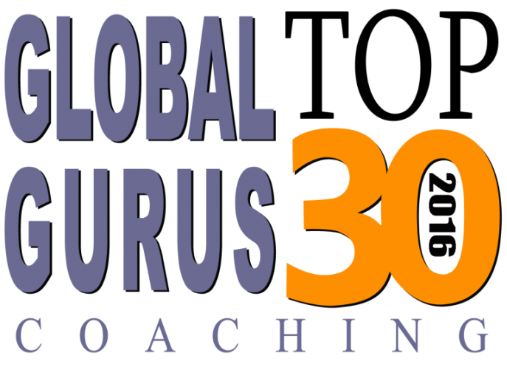
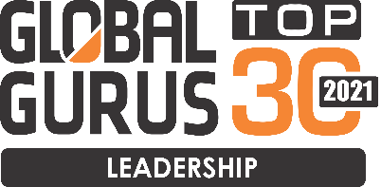
CEO and Executive Team Coaching and Mentoring
The success of a team is determined in part, by the personal success of the leader(s) of the team. Coaching is a key part of the personal journey for leaders who are transitioning from one leadership experience and approach to another. As leaders move from old to new behaviors and attitudes, the wise counsel of an advisor, who has been in these situations many times, can help to maintain and accelerate momentum and confidence along the journey. Lance Secretan has worked extensively as a personal coach to leaders in every field.
©The Secretan Center Inc. 2021
Notes:
The success of a team is determined in part, by the personal success of the leader(s) of the team. Coaching is a key part of the personal journey for leaders who are transitioning from one leadership experience and approach to another. As leaders move from old to new behaviors and attitudes, the wise counsel of an advisor, who has been in these situations many times, helps to maintain and accelerate momentum and confidence along the journey. Lance Secretan has worked extensively as a personal coach to leaders in every field. During the winter, Lance also invites teams to work with him at his home in the Rocky Mountains and in the summer at his home in Ontario, Canada.

Slide 10
The creation of a dream is a liberating and strategy-clarifying experience. There are three steps: 1] Identifying the dream; 2] Realizing the dream, and , 3] Sustaining the dream. The Secretan Center has developed a breakthrough system that invites leaders, their teams and all who contribute to the success of an organization, to identify, realize and sustain their dreams—their most extraordinary, outrageous, never-before-achieved aspirations. We call it the ONE Dream® Process
ONEDream®
©The Secretan Center Inc. 2021
Notes:
The creation of a dream is a liberating and strategy-clarifying experience. There are three steps: 1] Identifying the dream; 2] Realizing the dream, and 3] Sustaining the dream. The Secretan Center has developed a breakthrough system that invites leaders, their teams and all who contribute to the success of an organization, to identify, realize and sustain their dreams—their most extraordinary, outrageous, never-before-achieved aspirations. We call it the ONE Dream® Process. The first step involves defining the Permission Space, creating a “strategic map”, identifying the dream, and defining the implications of a radical dream for the organization and then developing a plan to achieve it. The Secretan Center brings the technology and the process for each these phases. Sometimes this can involve the design of our award-winning, customized, internally taught training programs to bring the hearts of employees along on the transformation. As one Fortune 100 corporate client observed, “The ONE Dream® created for our organization, led directly to the improvement of our employee engagement scores”, and another said, “This has helped our company to become one of the greatest success stories on the New York Stock Exchange in the last ten years.”

Slide 11

A subtle and effective way to test an organization’s appetite for Higher Ground Leadership® is to invite Lance Secretan to address an audience of leaders in which he describes the philosophy, shares case studies from the many successful implementations of this thinking around the world, and inspires everyone with a sense of excitement about the possibilities. When the audience develops energy around the ideas they have heard, traction quickly follows and this results in a design that is energized from within.
Keynotes and Workshops
©The Secretan Center Inc. 2021
Notes:
Very often, the most subtle and effective way to test an organization’s appetite for Higher Ground Leadership® is to invite Lance Secretan to address an audience of leaders in which he describes the philosophy, shares case studies from the many successful implementations of this thinking around the world, and inspires everyone with a sense of excitement about the possibilities. (He is ranked among the top 5 leadership speakers in the country). When the audience develops energy around the ideas they have heard, traction quickly follows and this results in a design that is energized from within.

Slide 12

The Secretan Center Inc. advises organizations and their leaders with corporate and personal transformation, strategy and visioning. We do this by working with leaders, inspiring them and their teams to create inspiring organizations that change the world.
Strategic Advisory Services
Lance Secretan is one of the most important leadership teachers of our time. His work is helping leaders to create organizations that are inspiring places for employees, customers, and suppliers.."
Marianne Williamson – Former US Presidential candidate, New York Times Best-selling Author
©The Secretan Center Inc. 2021
Notes:
We work closely with leaders and their teams, helping them to develop transformational ways to accelerate individual and corporate performance. The Secretan Center specializes in:
Raising business performance to breakthrough levels
Building powerful internal and external relationships with people and communities
Rebooting personal and corporate levels of inspiration (more than “engagement”)
(See a six-minute video of our work here http://www.youtube.com/watch?v=v06dbogrJKk)

Slide 13
Dr. Lance Secretan has a passion for rebuilding the integrity and inspiration of politics. He is an optimist who refuses to believe that our political systems are broken or irreparable. He has coached political leaders and advised political systems which, in turn, have led to their resurgence, helping them to restore respect and win back the approval of citizens and achieve new levels of performance and service excellence.
Political Advisory Services
©The Secretan Center Inc. 2021
Notes:
Dr. Secretan works with the leaders of cities, states and countries, coaching them to become exceptional leaders of their communities who build inspiring jurisdictions that reignite pride and passion among their citizens. Learn more here: http://secretan.com/consulting/corporate/political-advisory-services.

Slide 14

Each winter, leaders from around the world visit Dr. Lance Secretan in Colorado to learn how to significantly increase their leadership skills and to live lives that are inspiring to others. We call this invigorating, on-mountain experience, the Leadership Summit. New levels of skill and awareness are achieved by participants in a fraction of the time we usually expect for such breakthroughs. It takes passion, the willingness to let go of old ideas, an open mind for learning and change, a desire to improve—and most importantly—a firm belief that there are no limits.
Skiing and Leadership
©The Secretan Center Inc. 2021
Notes:
Several times a year, Lance Secretan, an expert skier, runs a three-day leadership retreat in the Rocky Mountains and the Alps, where participants learn how to become double-black diamond (expert level) skiers, while transforming their personal lives through a simultaneous, intensive leadership curriculum. The experience is life-changing. It is, of course, a metaphor for everything else in our lives—our roles as leaders, parents, spouses, friends, colleagues, and more. It offers a visceral experience that proves that radical change can be achieved quickly.

Slide 15
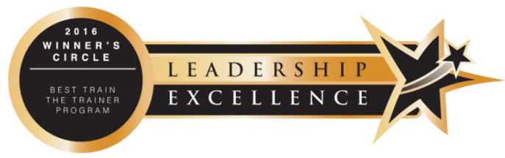
The DreamQuest® Program is the curriculum that covers Higher Ground Leadership® and supports corporate transformation towards the ONEDream®. It includes state-of-the-art leadership concepts and everything necessary for your facilitators, coaches and trainers (trained and certified by the Secretan Center) to deliver the materials to their employees or clients, or in their coaching work. We set out to create an experiential program that is both affordable and accessible for everyone, as well as being adaptable to the needs of any sized organization.
In-house Training Programs
©The Secretan Center Inc. 2021
Notes:
The entire curriculum for Higher Ground Leadership® has been converted into a DVD-based learning, award-winning program called the DreamQuest®. It consists of eighteen 10-20 minute modules filmed on the ski slopes in Colorado, canoeing and mountain-biking in Ontario, and in wine country, in which Dr. Lance Secretan presents a brief summary of each component, such as “inspiration”, “courage”, “service”, or “the science of using inspiring language”. Each module comes with an Instructor’s Guide and teachers are Certified by the Secretan Center to deliver these modules. The program is adapted to fit the current needs of clients and all necessary customized teaching materials are provided. A sample module may be viewed here

Slide 16
More than a program, this is a life-changing “learning experience” designed for those who wish to accelerate personal growth and learn new concepts of leadership and life based on Dr. Lance Secretan’s renowned philosophy called Higher Ground Leadership®. Members of the graduate community are called “Pathfinders”. “I hardly know where to begin in describing how being a Pathfinder has changed my life. Not only have I become a more conscious and effective leader of my 80-employee home health agency, but moreover, I use the practice of conscious leadership in every area of my life. The time and the tools that Lance has most generously given to those of us who chose to be part of this movement are invaluable and translate across all industries, cultures and spiritual paths. The moment I became a part of this Community, something deeply changed for me. It has been many years since my first Higher Ground gathering and I continue to refer to Lance’s books for inspiration and solace. And I will be forever grateful to Lance and all of the Higher Ground Community for this opportunity.” Pam Spiszman-Pegasus Home Health Care
Certification as a Higher Ground Leadership® Teacher or Practitioner
©The Secretan Center Inc. 2021
Notes:
A growing worldwide community of practitioners of Higher Ground Leadership® has been created. These practitioners come from a wide diversity of experience, backgrounds, training and geographies. They have embraced Higher Ground Leadership® as a philosophy which they are introducing to their own organizations, adding to their existing leadership development programs, or to their consulting and advisory practices. Certifications take place throughout the year in Colorado, USA, Ontario, Canada and Germany in Europe.

Slide 17
I have just completed Lance Secretan's Higher Ground Leadership® Coach Certification program. Not only did every class, and every call, inspire me each week, but the inspiration has continued to inspire me as I work with private coaching clients, preparing talks, and in my day to day personal life. Well worth the investment of my time! Thank you Lance and Deanna for hosting this program, and to Megan for continuing to lead the follow-up community. Marie McNeil – Certified Higher Ground Leadership® Coach
Certification as a Higher Ground Leadership® Coach
©The Secretan Center Inc. 2021
Notes:
For several years The Secretan Center has partnered with CoachVille, the largest coach training organization in the world, to offer a Higher Ground Leadership® Coaching Certification. This enables practicing coaches to enhance their offering to their clients by incorporating Higher Ground Leadership® in their coaching work.

Slide 18
Reading Group Guides lay out a plan for a team to discuss and learn about the ideas presented in each book and provide information about how to begin a dialogue, run a workshop or facilitate a meeting.
Reading Group Guides
©The Secretan Center Inc. 2021
Notes:
Dr. Lance Secretan has authored 18 books about leadership and a personal memoir. Reading Group Guides have been created for the most recent five…
A Love Story, (see the Book Discussion Outline)
The Spark, the Flame and the Torch, (see the Book Discussion Group outline)
ONE: The Art and Practice of Conscious Leadership
Inspire! What Great Leaders Do, and
Reclaiming Higher Ground
Book Discussion Group outlines lay out a plan for a team to discuss and learn about the ideas presented in each book and provide information about how to begin a dialogue, run a workshop or facilitate a meeting.

Slide 19

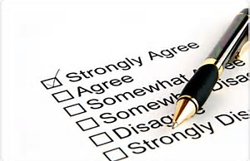
Helping You to Calibrate Leadership, Likeability, Corporate Culture and Climate, Stress and Inspiration... The Secretan Center offers many tools, surveys and other resources for organizations and individuals who are ready to commit to growth and positive change through their journey to Higher Ground Leadership®. We are pioneering breakthrough concepts of leadership and these tools, surveys and resources offer unique insights into how things are, and how they could be.
Assessment Tools
©The Secretan Center Inc. 2021
Notes:
The Secretan Center offers a wide variety of assessment tools. Generally, these seek to break new ground both through the methodology used as well as relevance.
The Vector 360° Leadership Survey measures the quality of leadership within an organization at the individual and team level. Upon completion, an eighteen-page report is produced. There is a limited, free, personal version of this assessment instrument here.
The CASTLE® Organizational Survey measures the cultural climate of an organization based on the breakthrough concepts described in ONE: The Art and Practice of Conscious Leadership, and The Spark, the Flame, and the Torch. A limited, free, personal version of this assessment tool is available here.
The Job Burnout Survey measures the level of stress being experienced by an individual in their work environment. This survey is free.
The SoulScreen measures the degree to which one’s soul (as opposed to the ego measured by more traditional instruments) is engaged by the current work environment. This survey is free.
5 Dynamics™ is an instrument that shows how we become inspired as a result of many things, one which is through building inspiring relationships. 5 Dynamics™ is an instrument that measures the way people learn and engage with each other. There are always dysfunctions in teams, and these tend to be uninspiring and act as brakes on high performance. 5 Dynamics™ represents a way to unlock inspiration in teams by removing the dysfunctions and restoring respect and passion, and showing individuals and teams how to collaborate in ways that lead to higher performance. A free limited version of this instrument is available with the purchase of The Spark, the Flame and the Torch, and can be located here.
Spirit@Work® Cards is a boxed set which includes a book and two sets of 77 illustrated cards containing key words and phrases that form the essential components of Higher Ground Leadership®. The words, such as authenticity, courage, empathy, humility, integrity, legacy, purpose, respect, service, and trust, are among the practices lived by inspiring leaders. The Spirit@Work® Cards are widely used for setting the tone of meetings, to provide inspiration during the workday, and as personal gifts of friendship and spirit. There is also an online application.

Slide 20

If I could choose but one person to work with for the remainder of my professional career, it is Lance. He is an inspirational leader who brings out the best in others, no matter what their title or task. He knows how to elevate everyone around him to achieve a level of excellence that is unexpected. His knowledge of corporate culture and leadership make him a huge asset to any corporation or organization looking to move to the next level. Lance successfully helped my organization earn a place on Fortune magazine’s 100 Best Companies to Work For four years in a row. Scott Regan, former COO, Memorial Health, Savannah, Georgia.
Dr. Lance Secretan
©The Secretan Center Inc. 2021
Notes:
Dr. Lance Secretan founded The Secretan Center after successful careers as a Fortune 100 CEO and an award-winning university professor and writer. Years of research and working with leaders from every field, including 30 of Fortune’s Most Admired Companies, and 11 of Fortune’s Best Companies to Work for in America, as well as leaders from academia, religious institutions, government and healthcare, have led to remarkable strategic transformations, corporate reinventions and stellar recoveries and performance. Also an expert athlete, he has sought to replicate the successes he had experienced in these disparate fields within executive teams, guiding them to unusual levels of high performance. Lance Secretan has documented many of these experiences in 19mportant books—many bestsellers—on organizational dynamics, high performance and building a sustainable organization in the 21st Century. He is supported by a world-class team of Certified Faculty, Coaches and Teachers.

