Slide 1
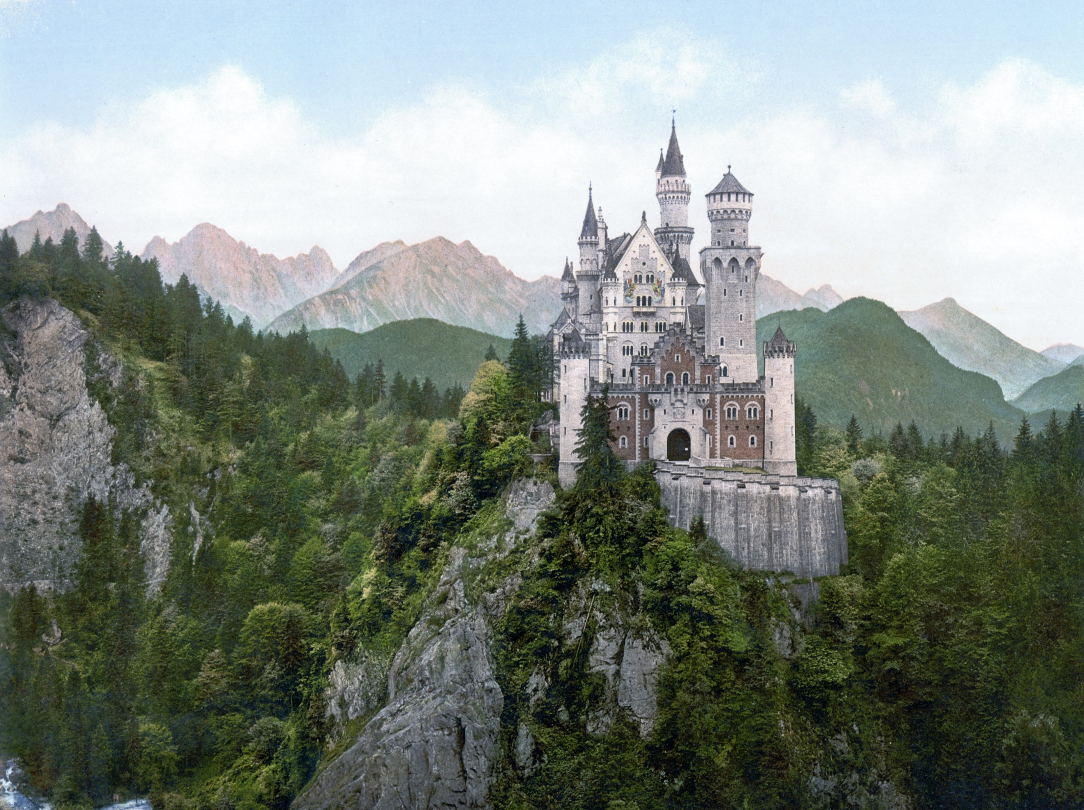

The CASTLE® Principles
The Six Ways of Being that are Changing People, Companies, Teams, Cities and the World
By Lance Secretan, founder and CEO, The Secretan Center Inc. www.secretan.com, @secretan

Slide 2
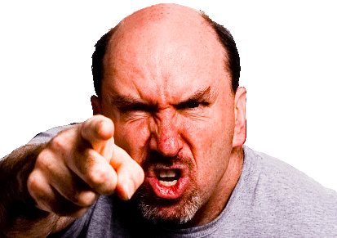
Where did the CASTLE® Principles come from?
We conducted research to find the answer to a key question:
What do you NOT like about leaders?

Slide 3
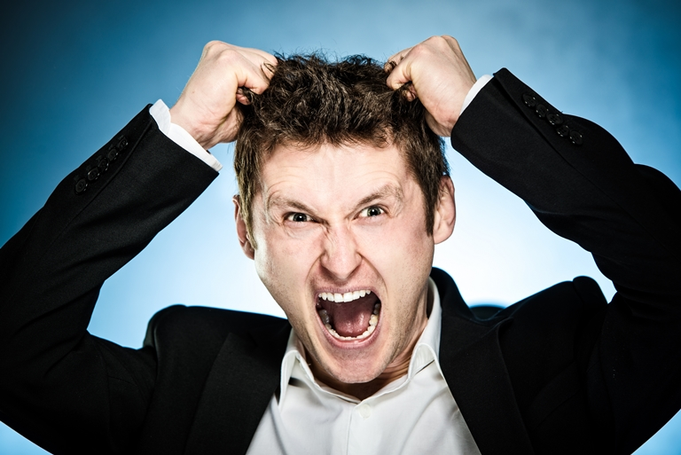
Here is what they said:
“We don’t like….

Slide 4
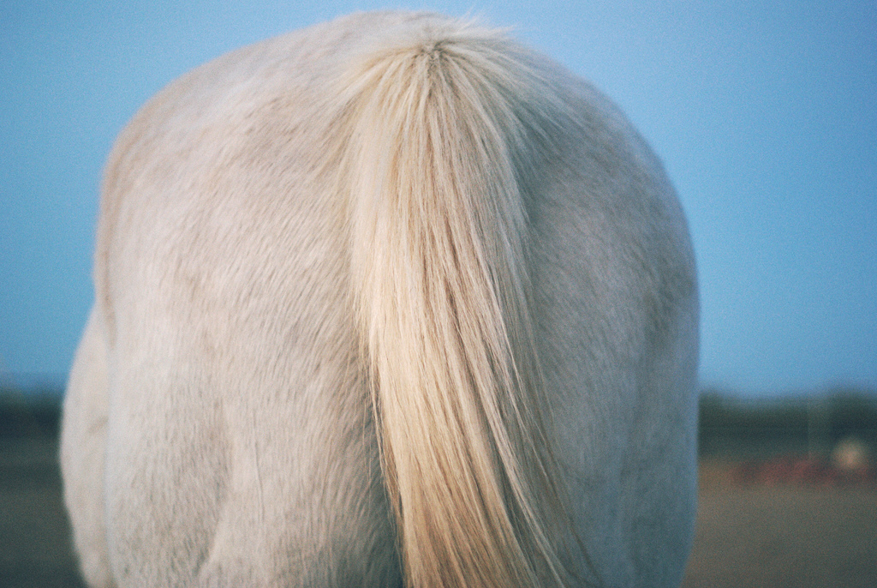
COWARDS
PHONEY LEADERS
SELFISH LEADERS
LIARS
FEARMONGERS
IDIOTS

Slide 5
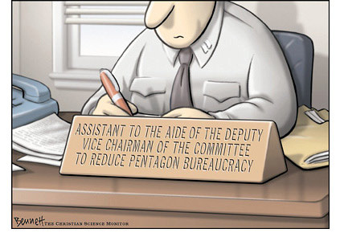
…and the amazing thing is that the majority of leaders think that these 6 characteristics that followers abhor:
….are the keys to their personal success!
  CYA and keeping your head down
  Political gamesmanship
  Looking out for “Number 1”
  Deceit
  Domination and Intimidation
  Mediocrity and Bureaucracy

Slide 6
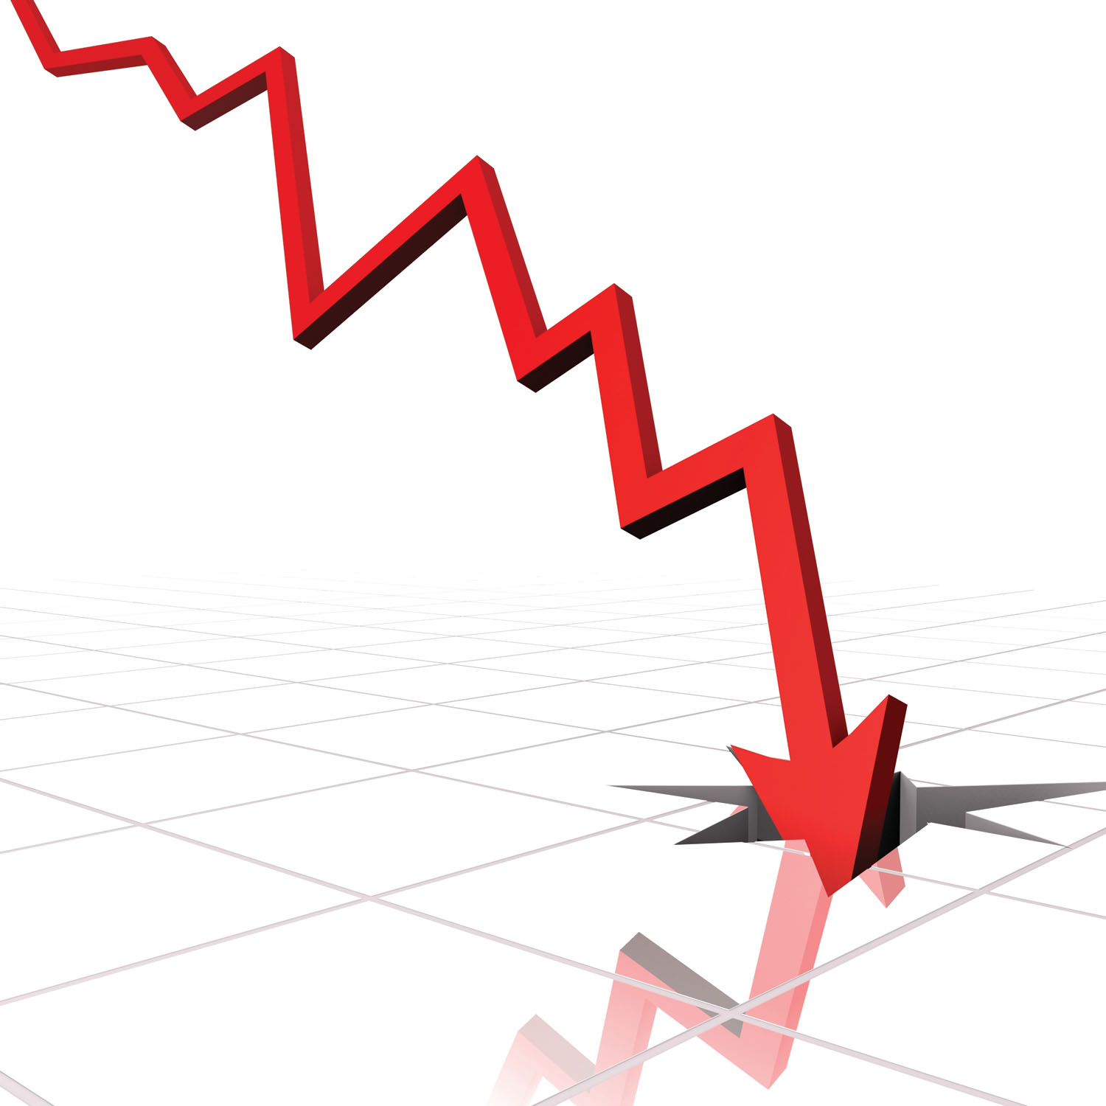
Think about it……….
This is how most people would describe their leaders
This is why 80% of the population doesn’t look forward to going to work on Monday mornings
This is why Gallup’s most recent research shows 30% of employees Engaged, 52% Disengaged and 18% Actively Disengaged (70% of employees actively or passively working against the strategic goals of the company).
This is why teams, companies, organizations and communities are so often UNINSPIRING.

Slide 7

The good news is that this is easy to fix!

Slide 8

All we need to do is the

Slide 9
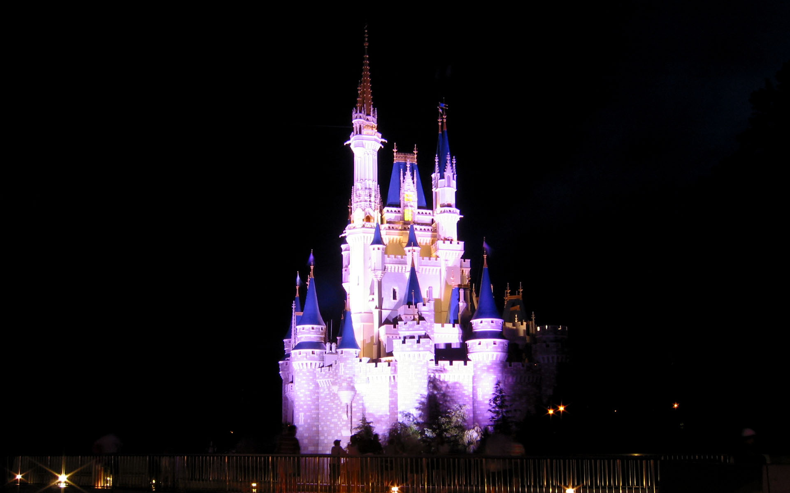
….and the opposite is………

Slide 10
The CASTLE® Principles

Slide 11

CASTLE® is an acronym for….
Courage
Authenticity
Service
Truthfulness
Love
Effectiveness

Slide 12
Let’s review them…..
Courage
“Reaching beyond the boundaries of our existing limitations, fears, and beliefs.”
It all begins with courage. We can't change anything, say sorry, or "I love you”, or change the world, without courage. Followers love courageous leaders.

Slide 13

Let’s review them…..
Authenticity
“Being genuine, transparent and aligned with our inner voice in all aspects of life.”
We are authentic when what we think, what we say, what we feel, and what we do, are aligned—the alignment of the mind, mouth, heart and feet. Followers love authentic leaders.

Slide 14
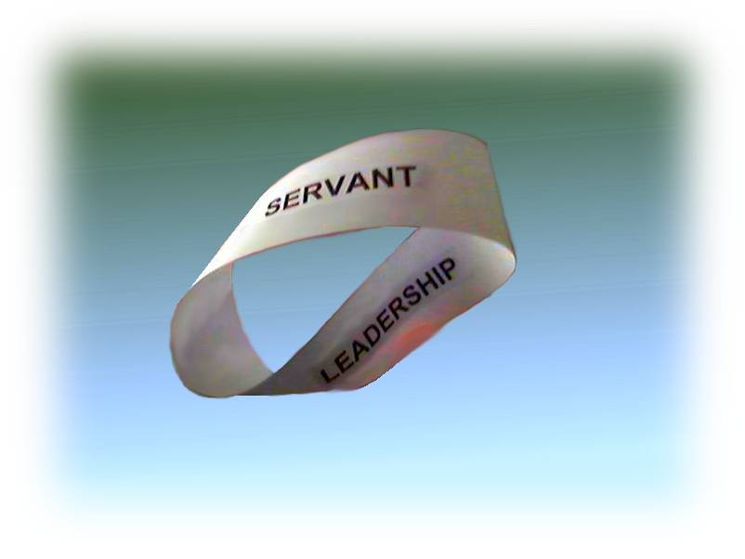
Let’s review them…..
Love
“Relating to others by touching their hearts in ways that add to who we both are as persons.”
We are afraid to use the word "love" in the workplace, and yet we all yearn to be loved in every part of our lives—including our work. Followers love compassionate and caring leaders.

Slide 15

Let’s review them…..
Service
“Willing and actively supporting the good of the other.”
The first responsibility of a leader is to serve others—employees, customers, shareholders, vendors, communities—all those who are stakeholders and whose lives we touch. Followers love servant leaders.

Slide 16
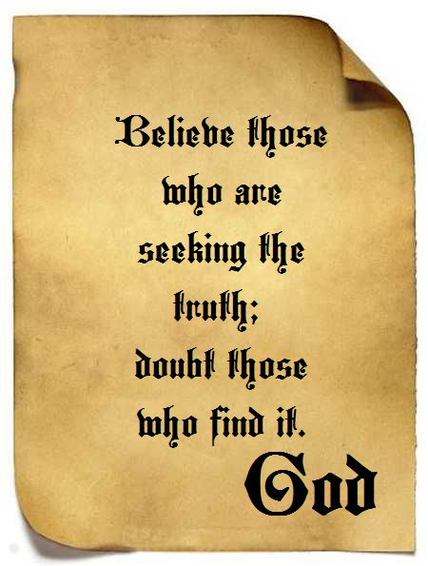
Let’s review them…..
Truthfulness
“Being honest and transparent in all thoughts, words, and actions.”
It is hard to find the truth—in business plans, budgets, expense reports, tax returns, resumes, performance reviews or marketing, but when the truth is told—in an inspiring way—it is like a breath of fresh air. Followers love truthful leaders.

Slide 17
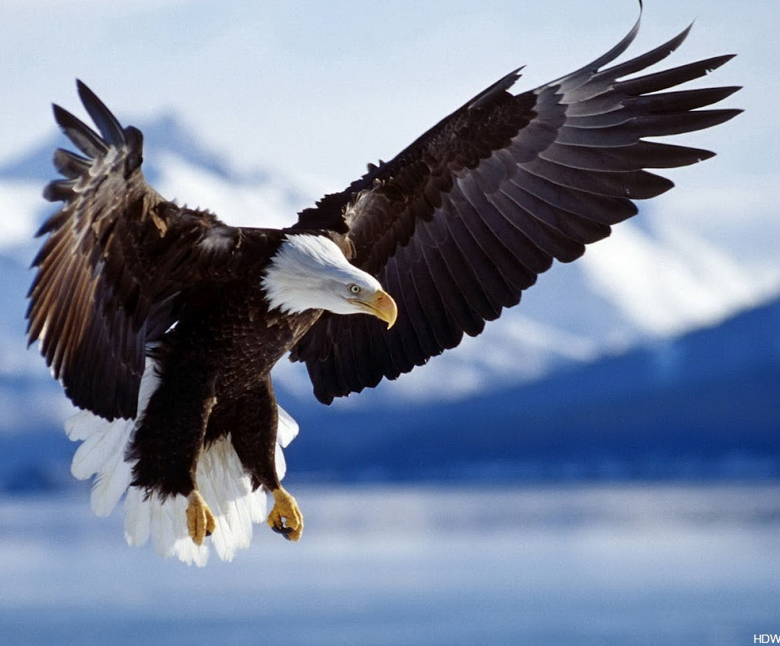
Let’s review them…..
Effectiveness
“Achieving desired outcomes successfully.”
Our chances of achieving our dreams, in all aspects of our lives, increase with the level of mastery of our leaders, and ourselves. Followers love competent leaders.

Slide 18

When we LIVE the CASTLE® Principles, we become inspiring leaders, who, as a result, inspire others, who build inspiring families, organizations and communities, and therefore change the world.

Slide 19


Slide 20




The Core Idea of “The Flame” in Higher Ground Leadership®
Lance Secretan
CEO and Founder of The Secretan Center Inc.
www.secretan.com

Slide 21
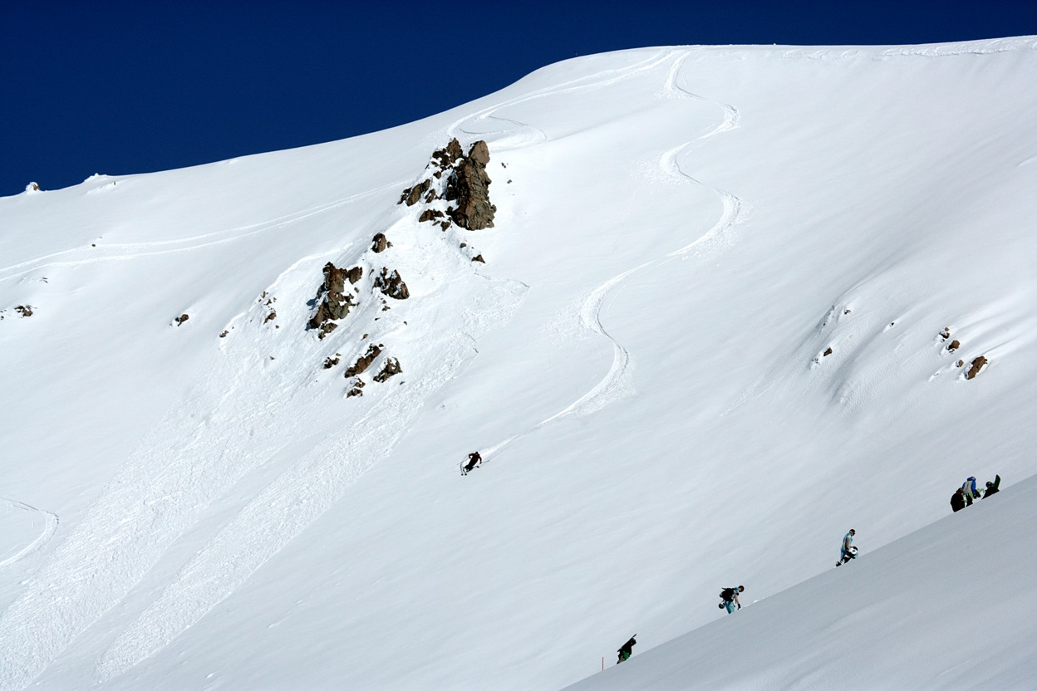
You might also be interested in:
A unique experiential learning event in the Rocky Mountains : http://www.secretan.com/training/leadership-summit-in-co-ski

