Slide 1
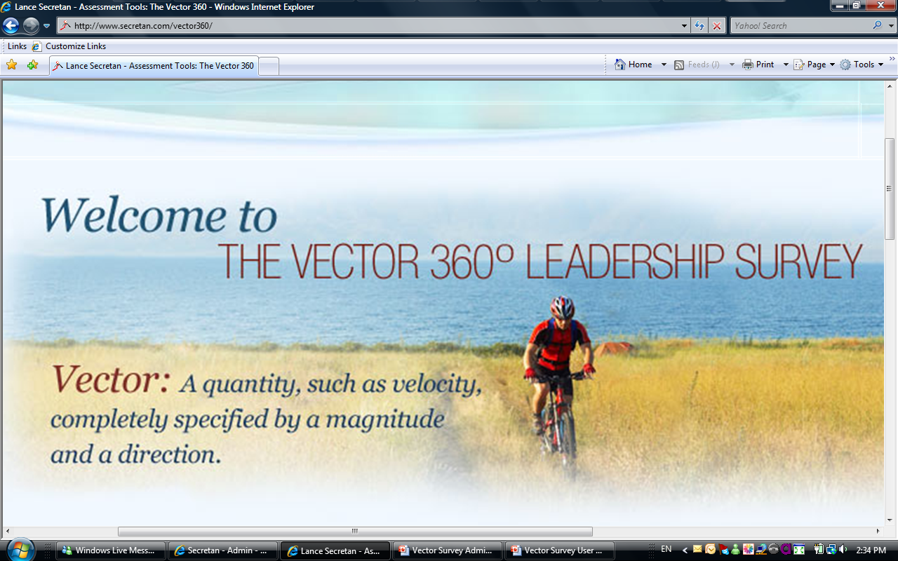
Vector 360 Leadership Survey User Guide

Slide 2



Slide 3


Slide 4
Vector Overview
Step 1:How I See Myself
Step 2:How I think others would describe me
Step 3: How I others actually see me
Step 4: How I see my team

Slide 5
User Login
Go to the Vector 360 Leadership Survey: http://www.secretan.com/vector360/
Enter your user name (case sensitive)
Enter your password (case sensitive)
Notes:
Complete Steps 1 to 4.
You have the opportunity to save and exit after each step or move on to the next step to complete the survey.
Note: For step 3 you will be asked to enter the email addresses of the peers and colleagues you want to request feedback from.
You have the option to view, print or email your results

Slide 6
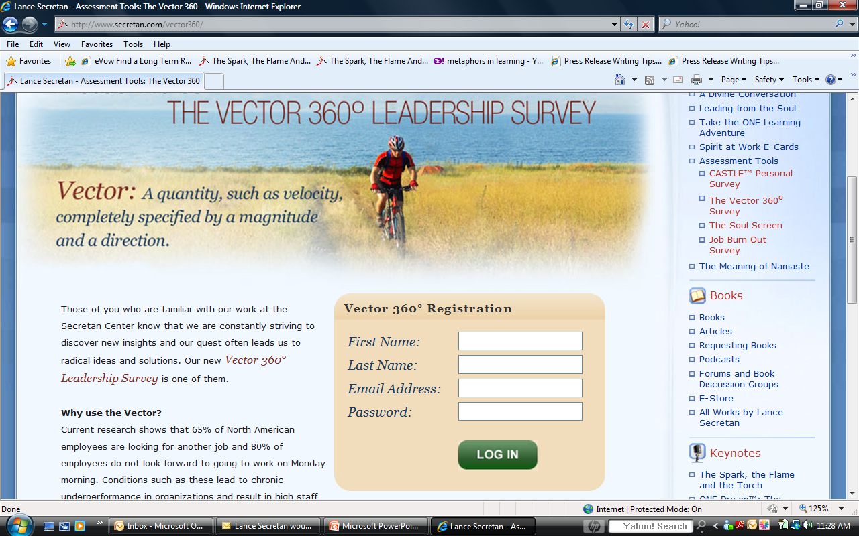
Welcome and Login Page

Slide 7
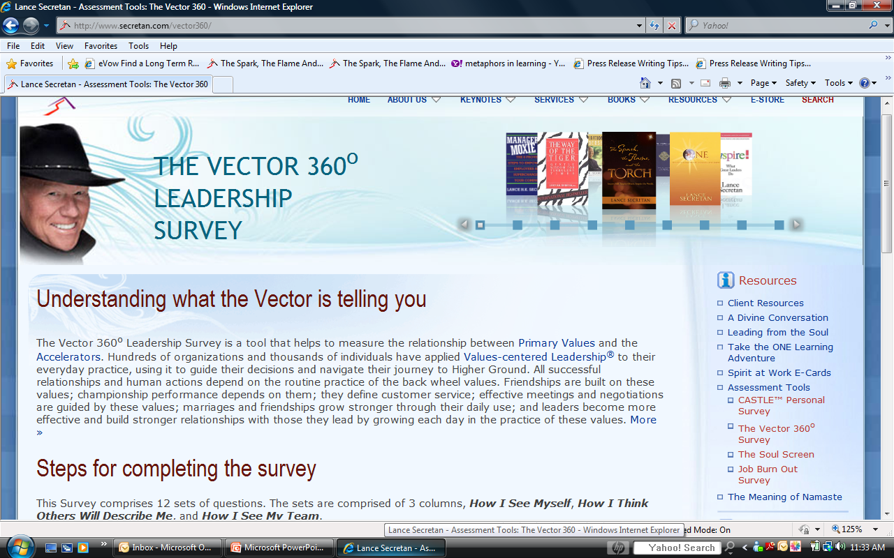
Overview of the Vector Survey

Slide 8
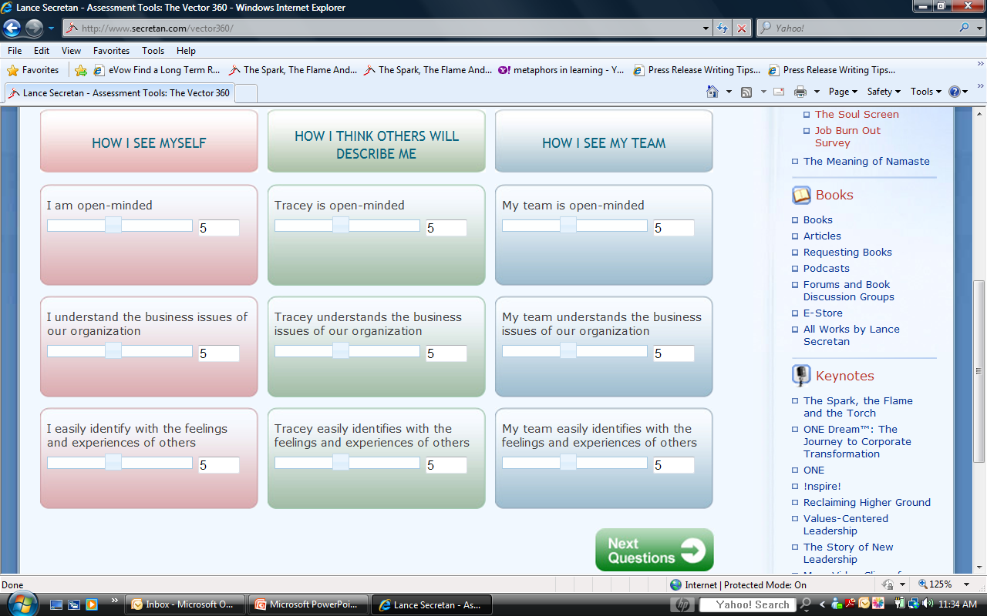
Start Survey

Slide 9
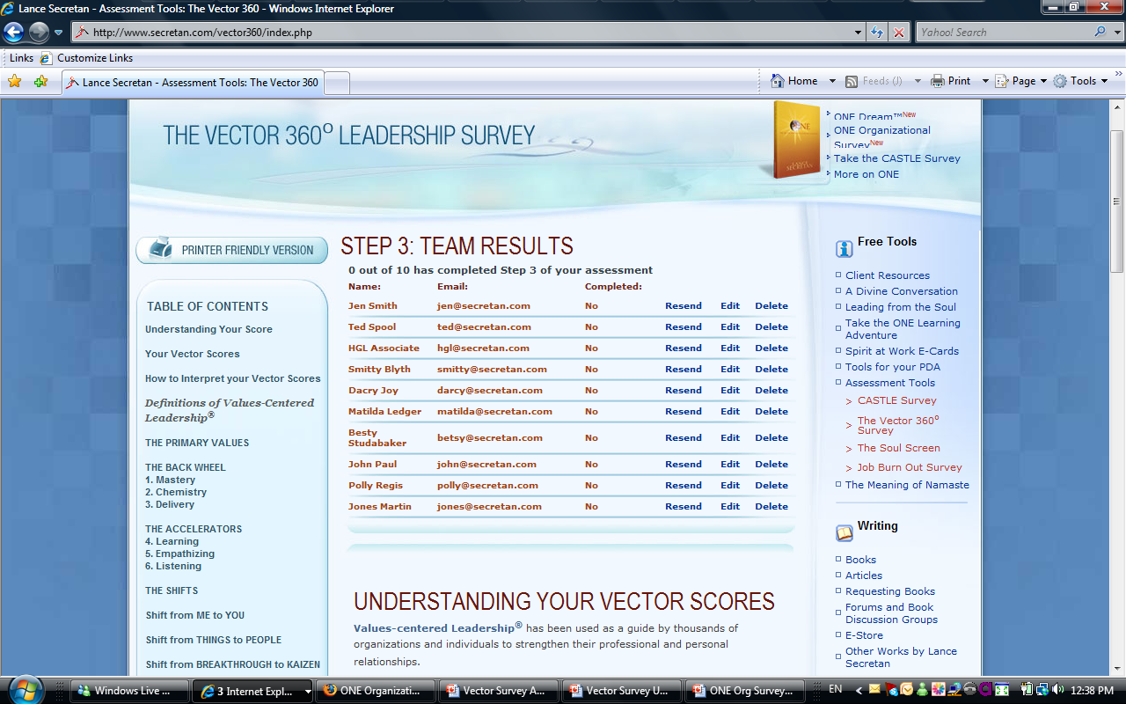
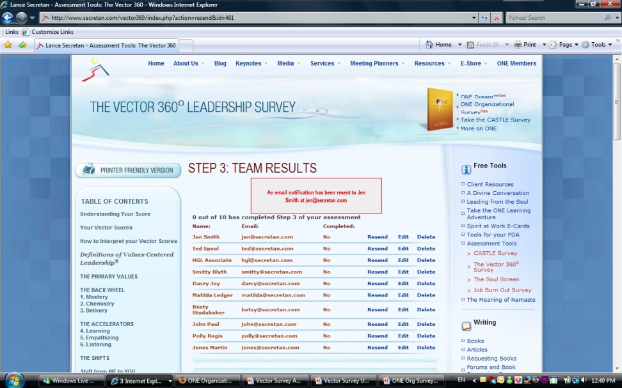
Monitoring Team Survey Submissions
View, Resend, Edit Email Addresses or Delete Team Requests

Slide 10
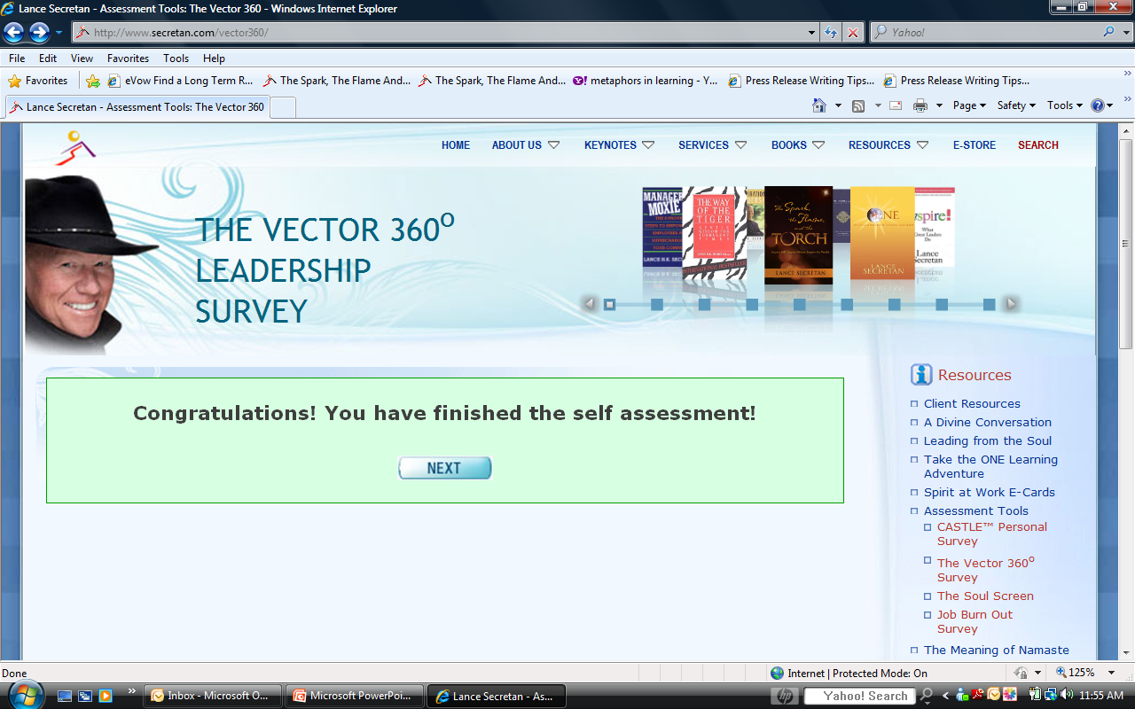
Completed Self Assessment

Slide 11
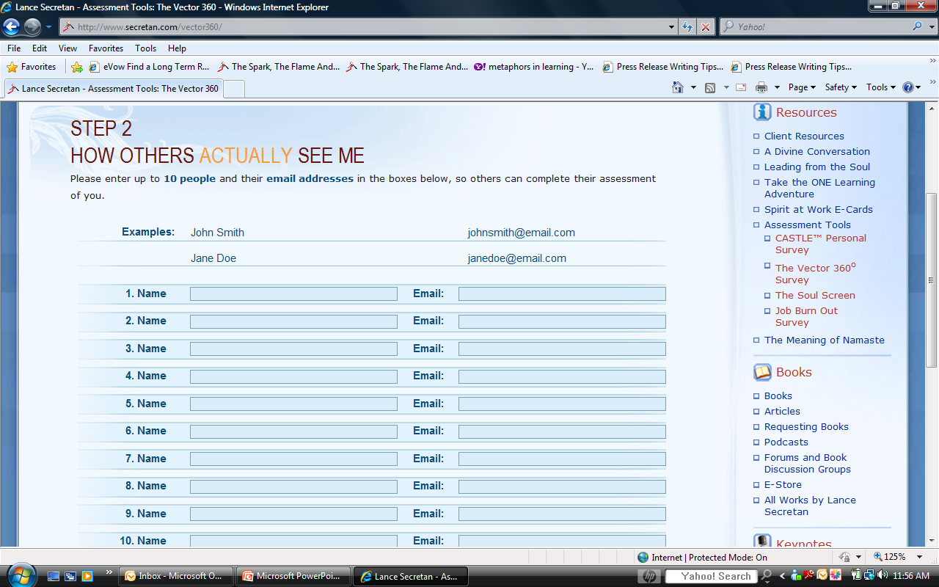
Step 2: How others actually see me

Slide 12
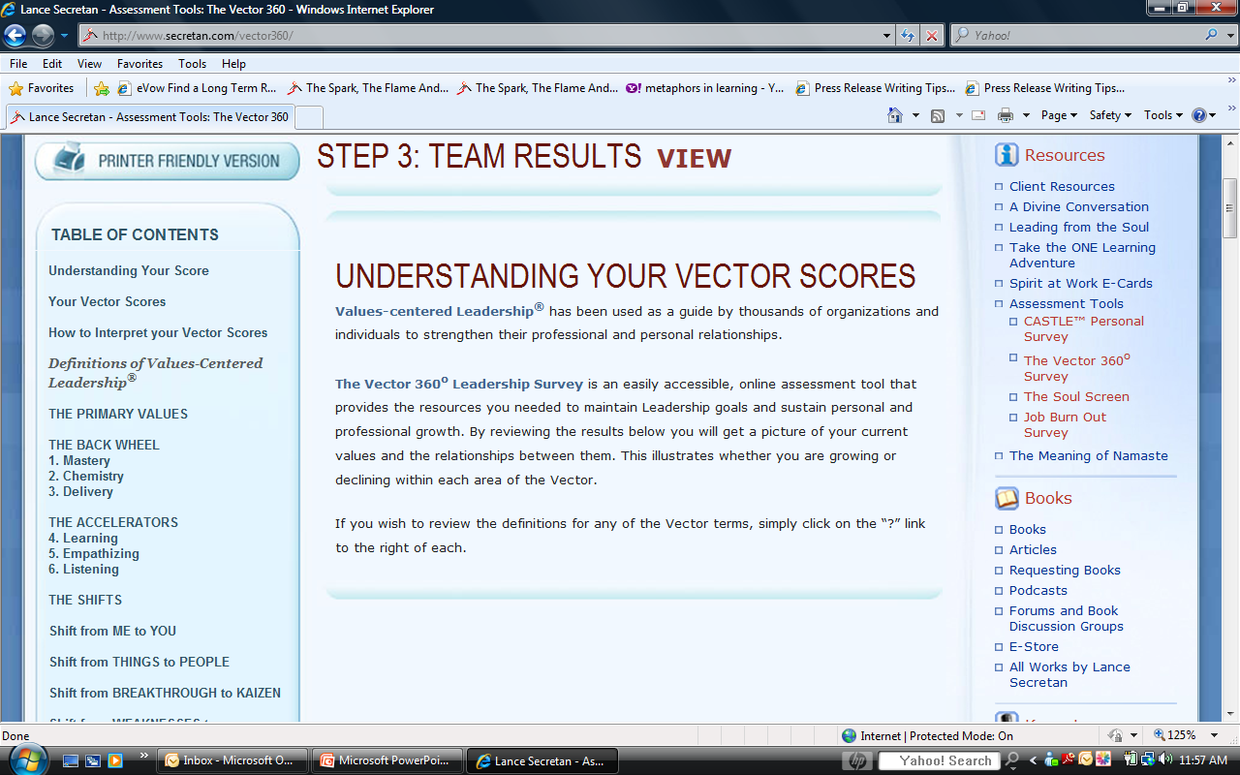
Step 3: Team Results

Slide 13
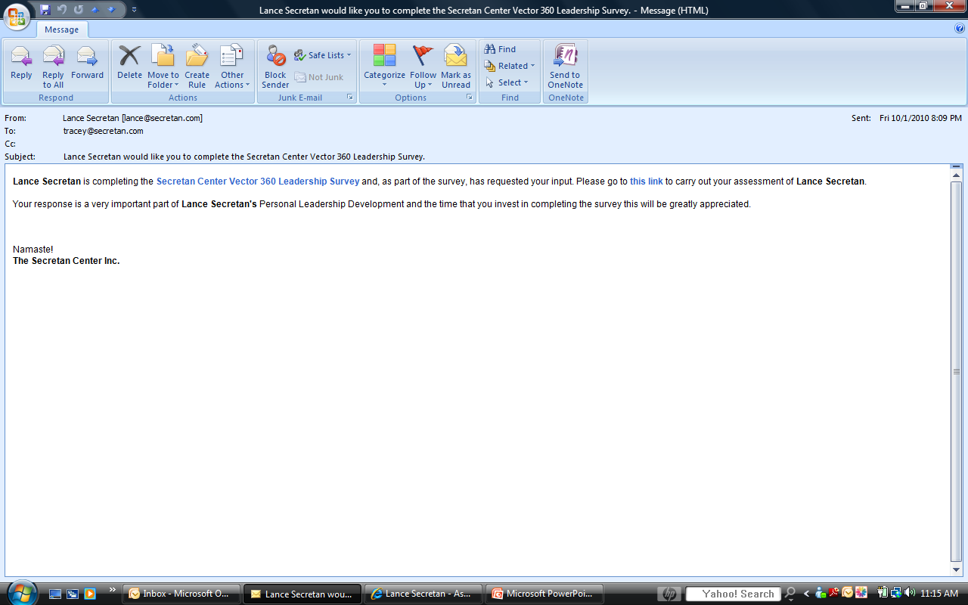
Team Email Request

Slide 14
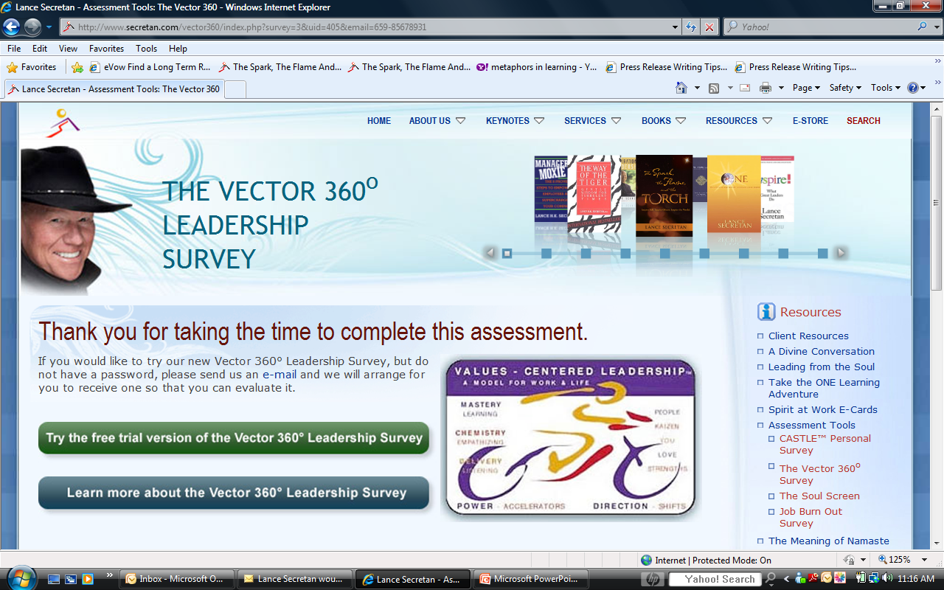
Team Member Completes Survey

Slide 15
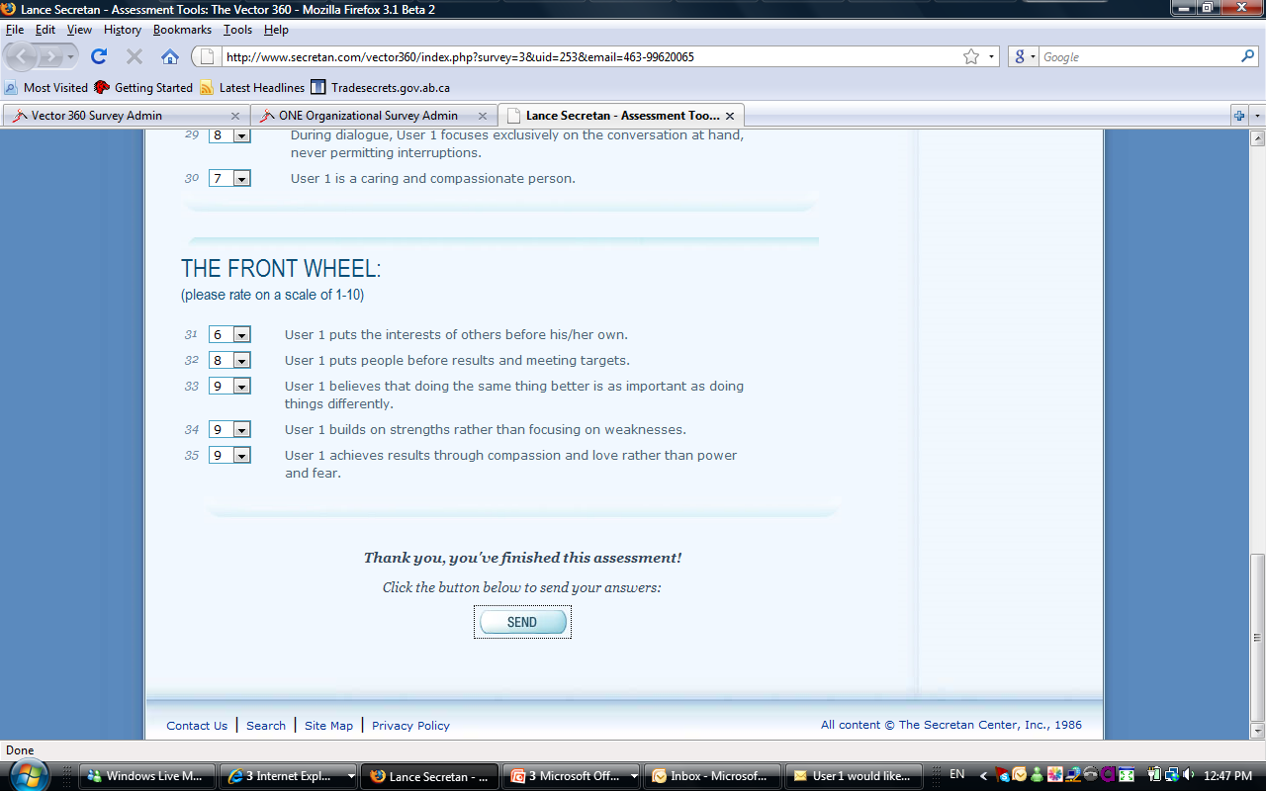
Submit Survey Responses

Slide 16
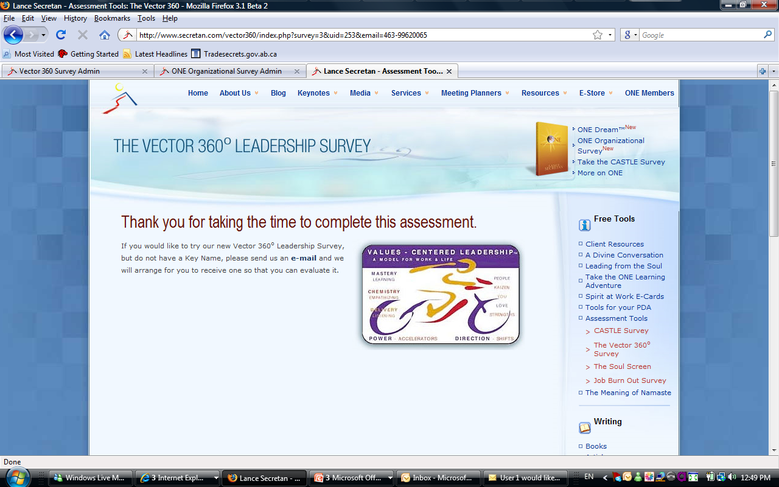
Thank You Message

Slide 17
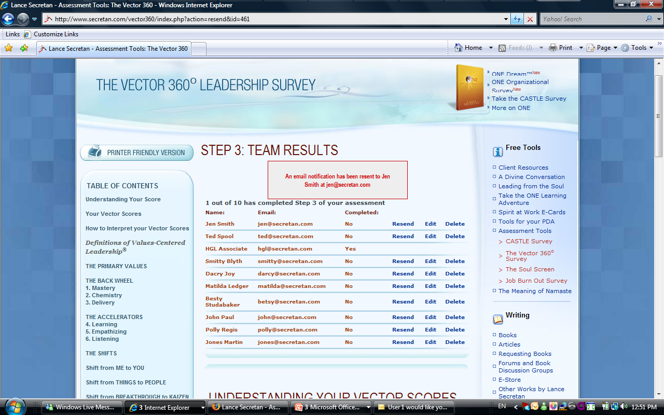
Monitor Team Feedback

