Slide 1

Higher Ground Leadership® Executive Coaching
Personal Dashboard
Learnings and Accomplishments
A Journal for Franco Maione

Slide 2
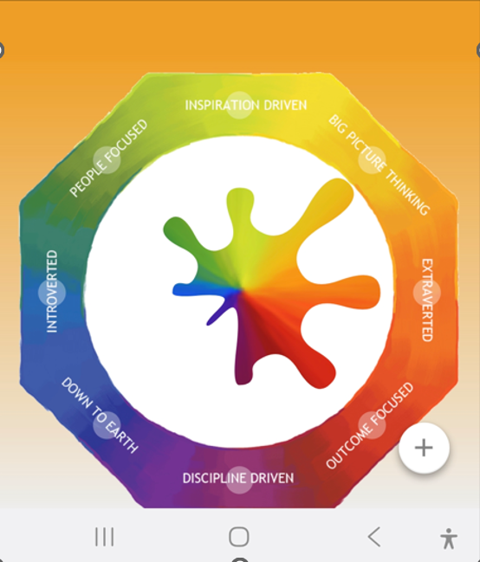
My Lumina Splash
A process for building inspiring relationships

Slide 3
My Why-Be-Do
Destiny
Character
Calling

Slide 4

My ONE Dream®
My Personal Dream is…

Slide 5
My ONE Dream®
My Corporate Dream is…

Slide 6
How I Will Live the CASTLE Principles®
Courage
Authenticity
Service
Truthfulness
Love
Effectiveness

Slide 7
My Personal Commitment
Using the same extraordinary Courage I have previously demonstrated in my life, I will commit to:

Slide 8
What I Learned About Myself
Work
Home
Relationships
Physical
Spiritual
Financial

Slide 9

What I Plan to Do

